Slide 1
Final Project Presentation
-ResNet-
2020095178 최윤선
Colab Link: https://colab.research.google.com/drive/1osTSRTRdpXRdUTCvDNnAjwDhkjxbx7xv?usp=sharing
Reference Paper: Deep Residual Learning for Image Recognition (ResNet)

Slide 2
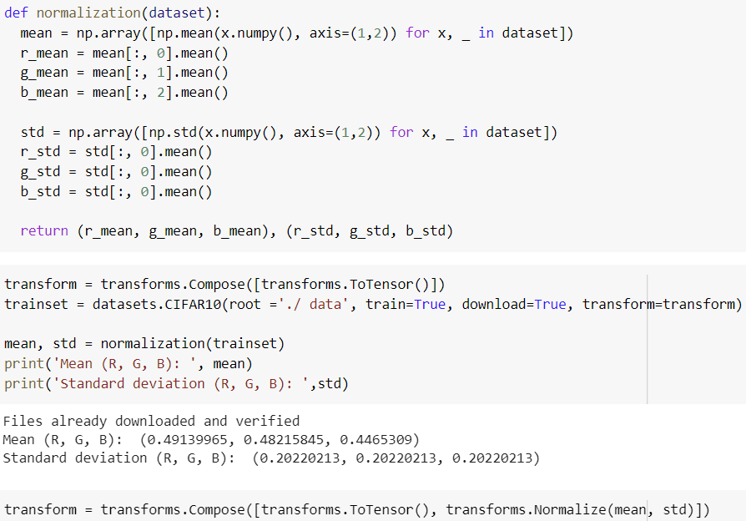
Data Normalization
For better data normalization, I used the mean and standard deviation of the R, G, B data of the train dataset, instead of 0.5.
The function of calculating
the mean and standard deviation
The mean and standard deviation of R, G, B

Slide 3
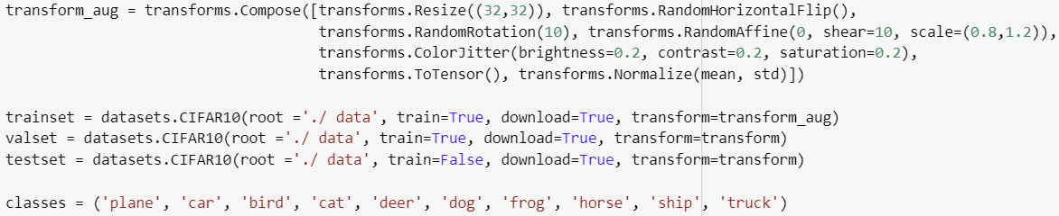
Data Augmentation
For higher accuracy, I applied various data augmentation method on train dataset.
transforms.Resize(): Resize the image.
transforms.RandomHorizontalFlip(): Invert left and right with the defined probability of p. (The default value of p is 0.5.)
transforms.RandomRotation(): Rotate the images randomly at a given angle.
transforms.RandomAffine(): Do a random affine transformation like rotating or moving.
transforms.ColorJitter(): Arbitrarily change brightness, contrast, saturation, color tone.

Slide 4
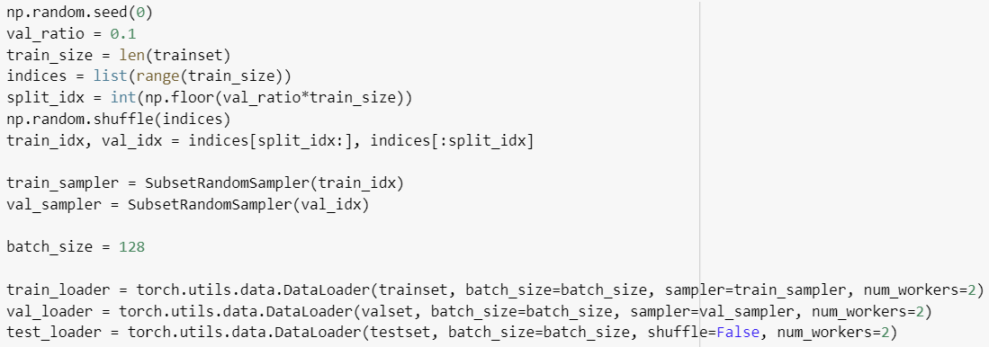
Data Loader
Divide the dataset into train, validation, and test dataset.
Set the batch size to 128 according to the paper.

Slide 5
Model Architecture – ResNet44
Implement the commonly used convolutional layer as a function.

Slide 6
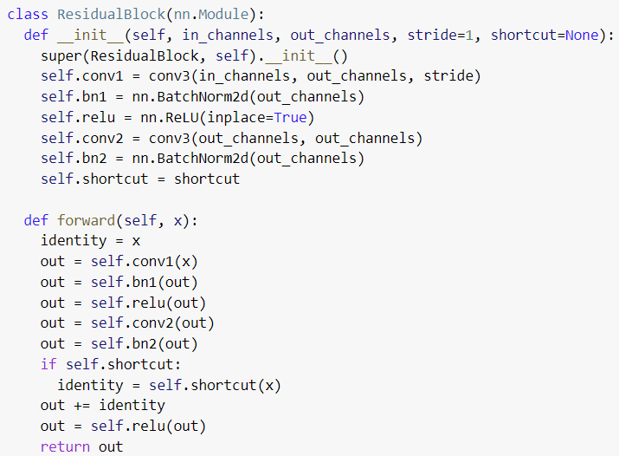
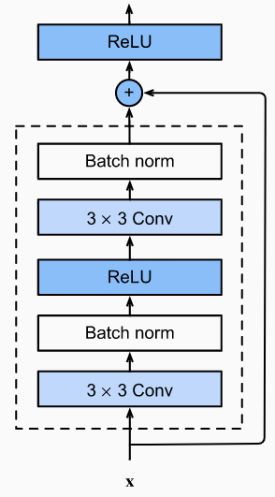
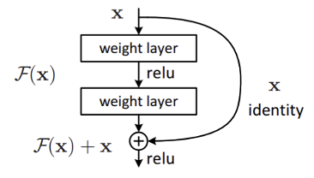
Model Architecture – ResNet44
Residual Block

Slide 7
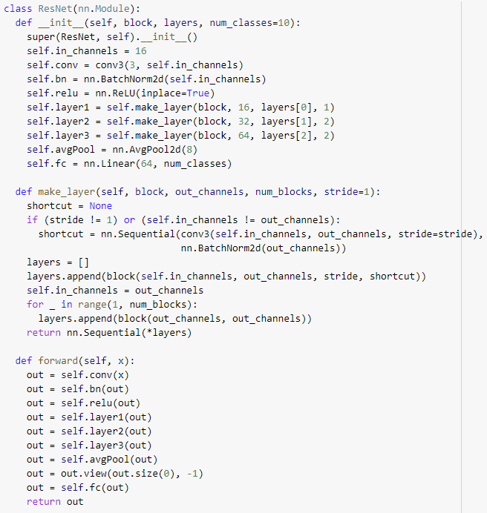

Model Architecture – ResNet44
Main Block

Slide 8
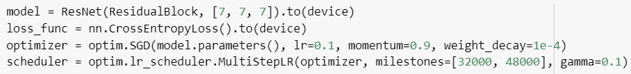
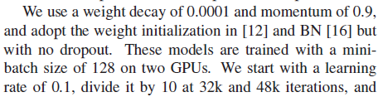
Model Architecture – ResNet44
Define the model
According to the paper
Set n=7 and create ResNet model with 44 layers.
The optimizer is SGD and set the initial learning rate to 0.1, momentum to 0.9, and weight decay to 0.0001.
Use MultiStepLR method to control the learning rate.
Decay the learning rate of each parameter group by gamma=0.1,
once the number of epoch reaches one of the milestones(32000~48000 step).

Slide 9
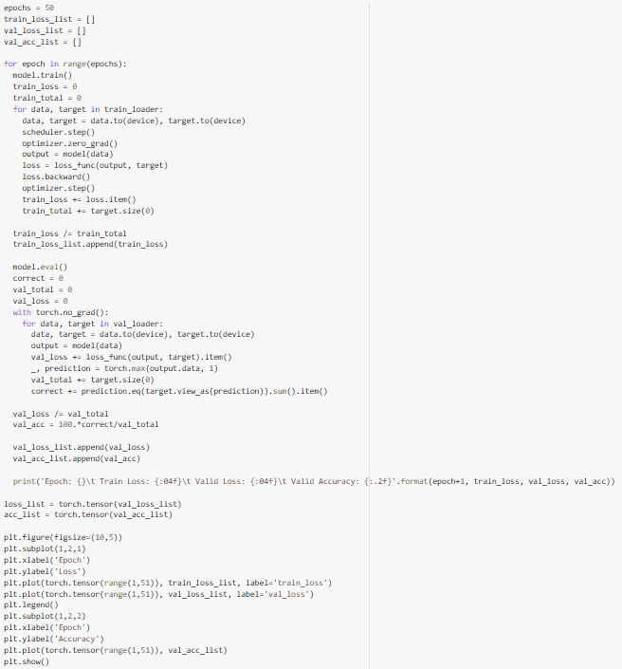
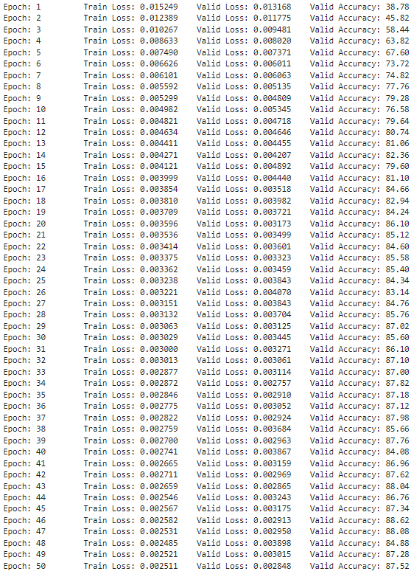
Train & Validation

Slide 10
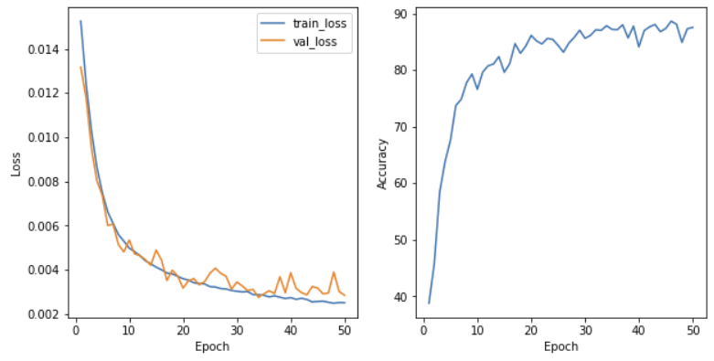
Train & Validation
Result Graph

Slide 11
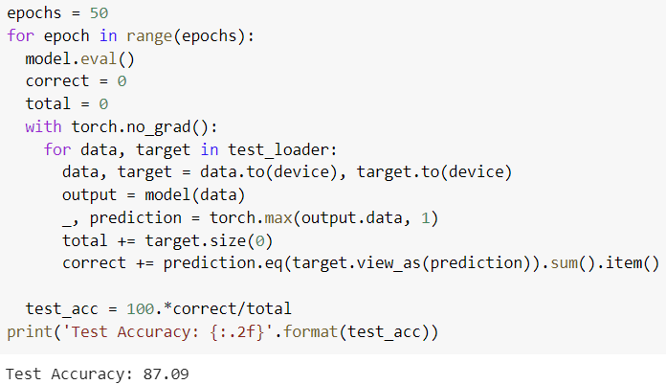
Test – Final Accuracy
Final accuracy is 87.09%!!

